Slide 1
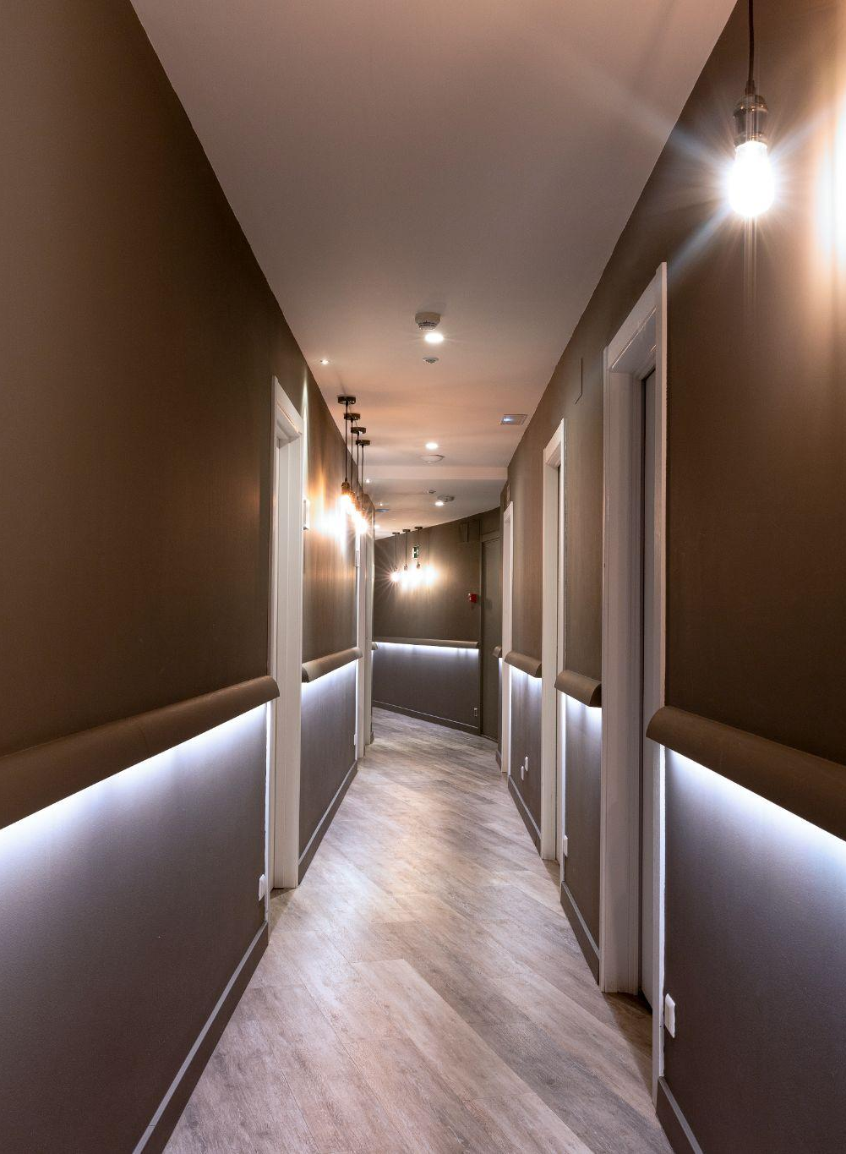
SMART ROOM ACCOMMODATION AND TRACKING SYSTEM
HOSTEL

Slide 2
Under the Guidance of : S. Radha
Done By :
Abburi Bhavya Sri (21R11A05A5)
Kosuru Bharath Kumar (21R11A05C8)
Busholla Srinath (21R11A05B5)

Slide 3
CONTENTS
Introduction
Existing System
Proposed System
System Configuration
Implementation
Conclusion & Future scope

Slide 4
Introduction
Hostels are essential in providing accommodations for students, faculty, and staff in educational institutions.
They ensure that individuals have a comfortable living environment, which is crucial for academic success and overall well-being.
Traditional methods of hostel management are often manual and prone to errors, leading to inefficiencies.
Issues include double bookings, underutilized or overcrowded rooms, and a lack of transparency in room allocation.
The Smart Room Accommodation and Tracking System aims to streamline room allocation, track occupancy, and optimize resource planning.
The system provides a user-friendly interface for both administrators and residents, enhancing the efficiency of hostel operations.

Slide 5
Existing System
Limitations of Current Systems:
Cloudbeds: Unified dashboard and automated room allocation, but reliance on real-time data can lead to synchronization failures.
Hostelworld: Real-time availability and user reviews, but biased feedback and limited room availability updates can result in overbooking.

Slide 6
Proposed System
Room Management: Organize availability, allocation, and booking status.
Color Coding: Display room occupancy status with color-coded indicators.
Booking System: Manage reservations, prevent double bookings, and optimize room utilization.
Real-Time Room Availability: Display up-to-date information on room occupancy.

Slide 7
System Configuration
Software Requirements
Operating System : Windows
Database Management System : MySQL
Programming Language : PHP, HTML, CSS, JavaScript
Development Tools : Visual Studio Code
Hardware Requirements
Processor : intel i3
Memory : minimum 8GB

Slide 8
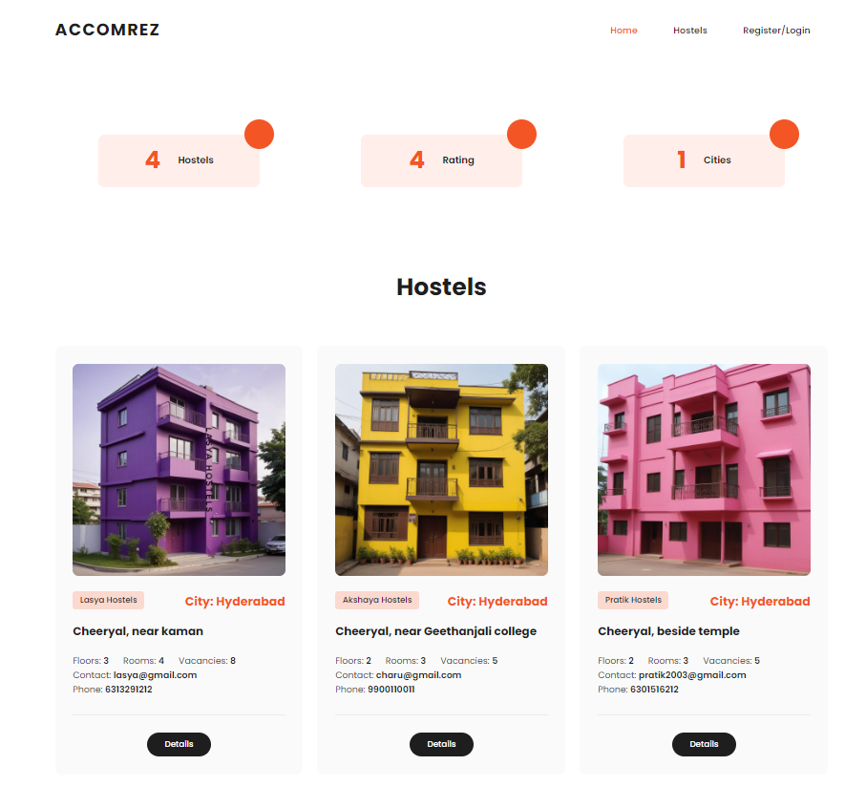
Implementation
Implementation of the Smart Room Accommodation and Tracking System as a web-based application.

Slide 9
Conclusion & Future scope
Conclusion:
The system improves overall hostel management by automating key functions, which leads to better resource utilization and a more comfortable living environment for residents. It fosters a more organized and efficient process, making it easier for students, faculty, and staff to secure accommodations and for administrators to manage them effectively.
Future Scope:
Future developments could include integrating the system with additional campus services, such as dining, to provide a more comprehensive management solution. Another enhancement could be the implementation of advanced predictive analytics to further optimize room allocations and resource planning based on trends and historical data.

Slide 10
Thank
You!

